Slide 1

Project 2nd Phase on Weather Prediction and Alert System
Karnatak Law Society’s
Gogte Institute Of Technology, Belagavi
By
MIHIKA MALGI (2GI16EC075 )
MOHAMMADFAIZ BAWA (2GI16EC078 )
POONAM PATIL (2GI16EC101)
PRIYA SHETTI (2GI16EC109 )
Under The Guidance Of
DR.VEENA DESAI
(Professor –Dept of EC)

Slide 2
Content
Sl No | Topic
1 | Status of the Project until Completion of Project Phase 0 and Phase 1
2 | Project Classification
3 | Demonstration of the Work completed till now.
4 | Timeline

Slide 3
Status of the Project until Completion of Project Phase 1
Verified various Machine Learning Algorithms like linear regression and random forest algorithm and finalized the random forest algorithm as results in better accuracy.
Started working on mobile application building and integration of machine learning code with the mobile application.
Reviews :
Improvise more with the machine learning algorithm and specification of all functions and libraries used.

Slide 4
Project Work Classification
The project weather prediction is categorized as Earth and environmental sciences and forecasting using pattern recognization.
This is build as a software for contribution to website which focuses output according to the user.
Project is divided into three modules
1). Data Processing.
2).Prediction Algorithm.
3).User Interface(UI)-Mobile Application.
The sources used for the project are :
1).For data set collection in csv format from websites like Weather underground, World weather online, Varuna Mitra etc.
2).For prediction, algorithms used are Decision tree algorithm, Linear regression algorithm and Random Forest Algorithm.
3).Software used is Python3 on Platform JupyterLab, Android Studio.

Slide 5
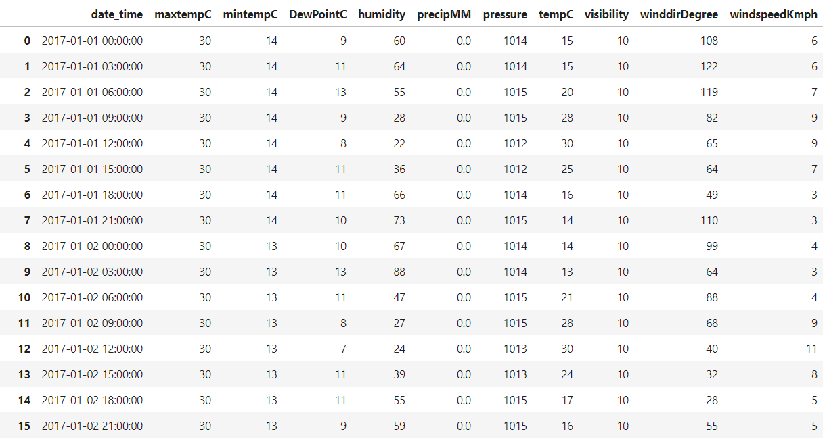
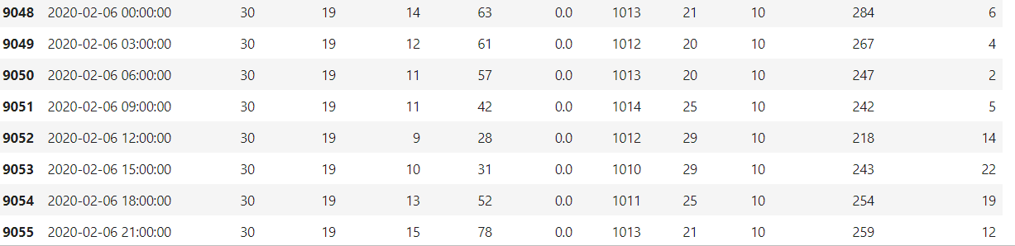
Weather Dataset collected for Belgaum

Slide 6
Algorithms
Till now we worked on 3 algorithms.
1)linear regression
2)decision tree
3)random forest regression
We worked with these 3 algorithm to select a algorithm with best accuracy to predict.
By using them we got to know that linear regression gives 91.9% accuracy, decision tree algorithm gives 86.8% accuracy and random forest regression gives 99.7% accuracy.
RFA gives high accuracy by a technique called bagging.
It has lot of advantages over other ML algorithms.
By considering above features of RFA. It is used in this project for accurate prediction of weather data.

Slide 7
Linear Regression Algorithm
Linear regression is a linear approach to form a relationship between a dependent variable and many independent explanatory variables.
Linear regression attempts to model the relationship between two variables by fitting a linear equation to observed data. One variable is considered to be an explanatory variable, and the other is considered to be a dependent variable.
A linear regression line has an equation of the form Y = a + bX, where X is the explanatory variable and Y is the dependent variable. The slope of the line is b, and a is the intercept (the value of y when x = 0).
.

Slide 8
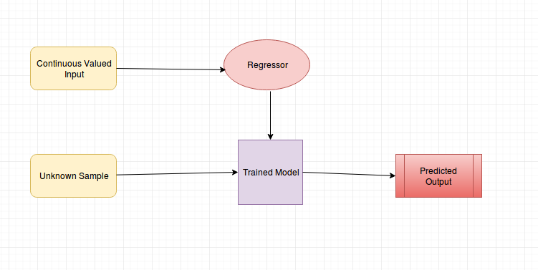
The main drawback is that we attained accuracy for the following algorithm was 91% and we were aiming for better accuracy.

Slide 9
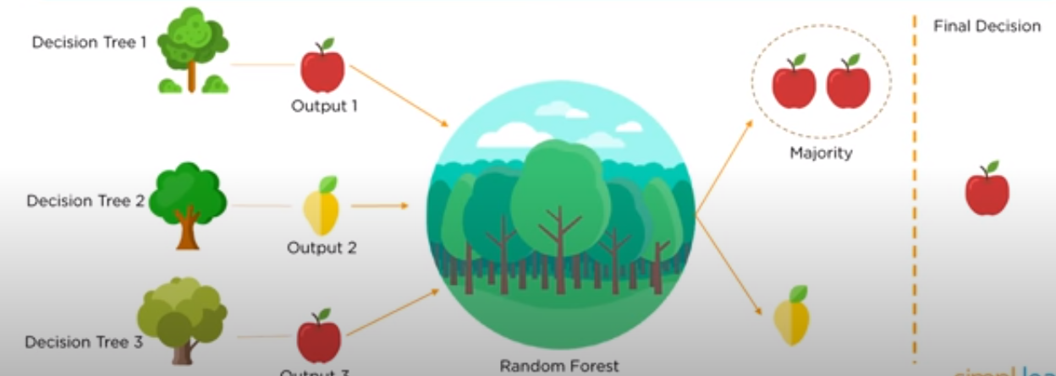
Random Forest Algorithm
Method that operates by constructing multiple decision trees.
Decision of majority trees is the final decision.

Slide 10

Simplified image of RFA

Slide 11
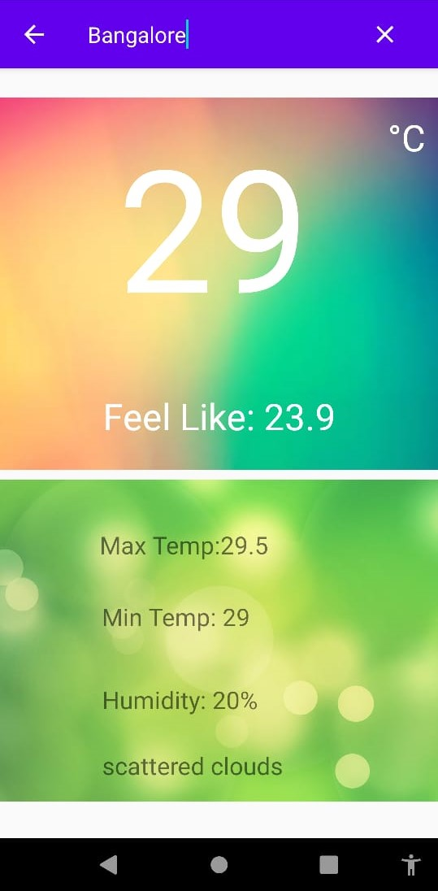
UI : Android app
The user interface for the ML code is as fig.1
Aim is for relatively easy interface.
Name of the region or city for which weather data is displayed is on the top of the app
Fig.1 App for display of weather

Slide 12
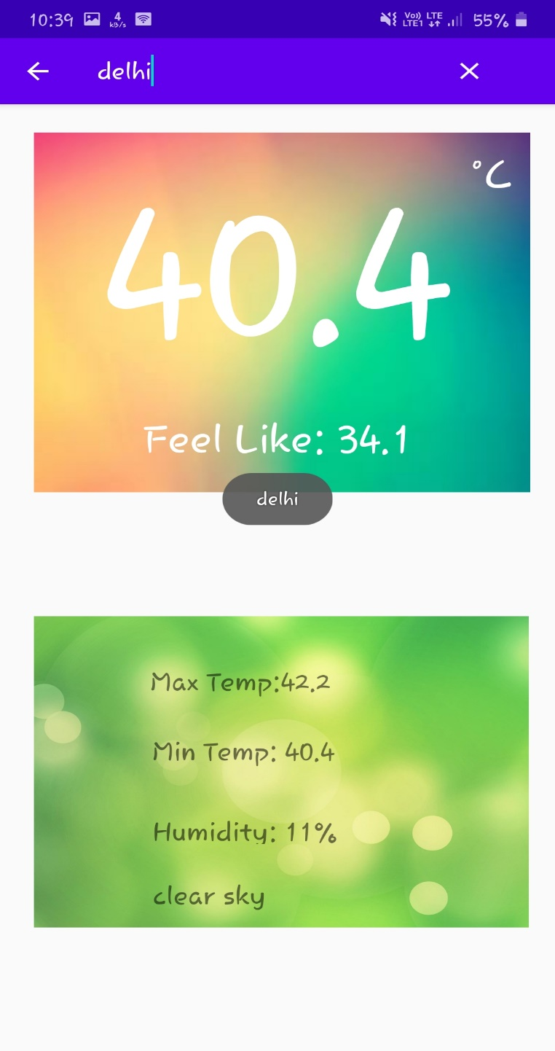
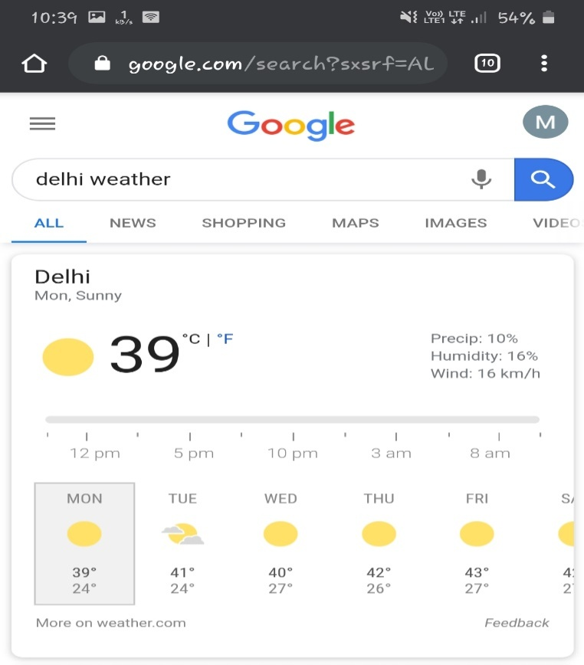
Comparison

Slide 13
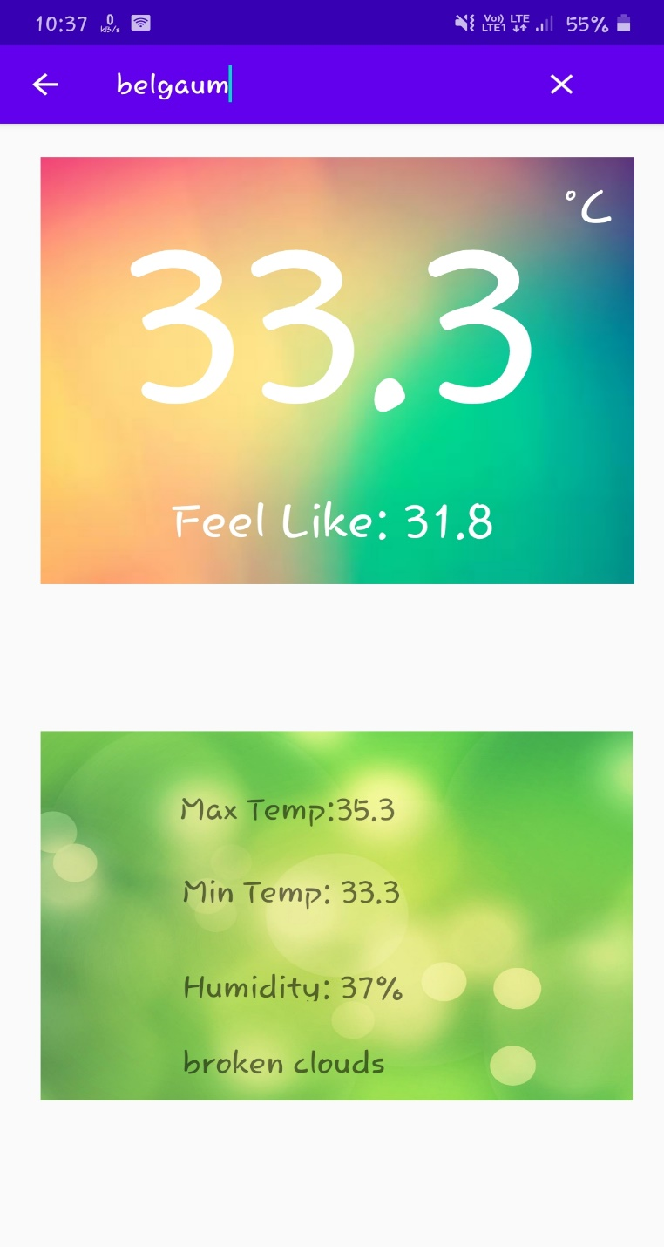
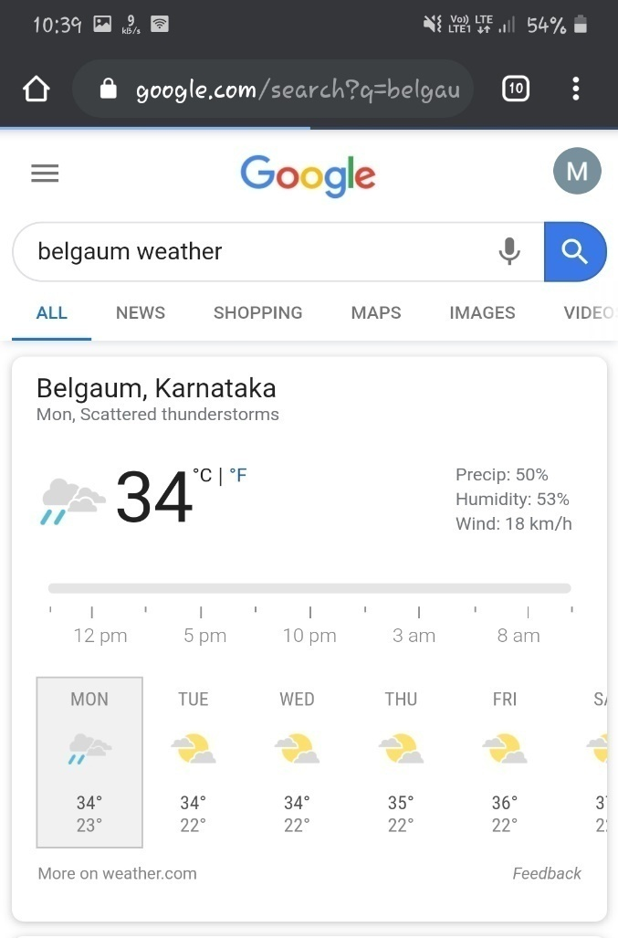
Comparison

Slide 14
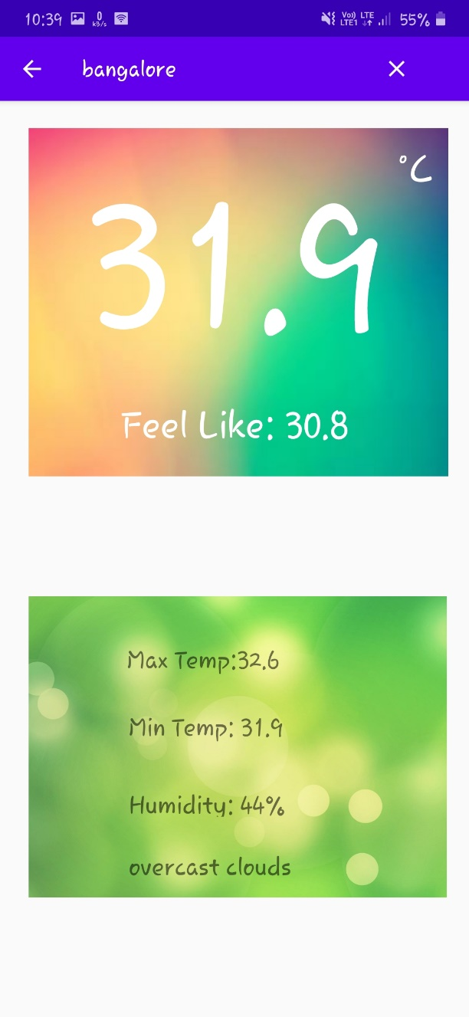
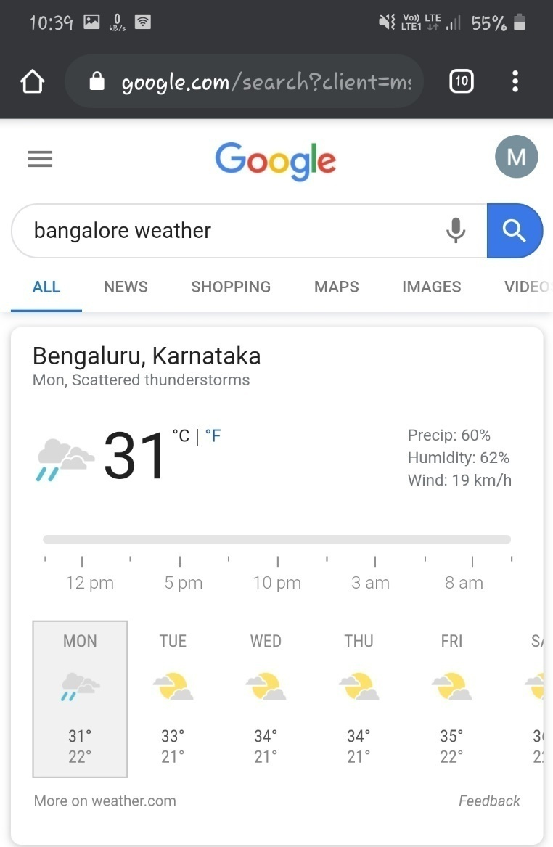
Comparison

Slide 15
Deploy ML Weather Prediction Code
Model Building: A suitable Machine learning Model pipeline to Predict the weather using the datasets from WWO is build.
Setup API : Create an API using flask server.
App : Here, we will design a user interface where the user can type his region.
Get the data: Once we get the region from the user, we will use the API to get the data related to the searched location.
Predict weather and send results: Next, use the saved model to predict the weather of the region and send the results back to the app.

Slide 16
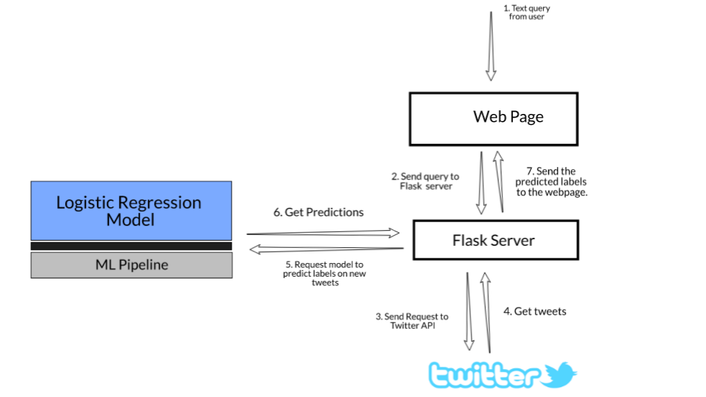
Deploy ML Weather Prediction Code
App
Machine learning
Model
App
data
data
WWO
World weather online
Fig.2 Flow diagram to deploy ML code

Slide 17
Further update for the App
A new page in the android app for the display of future predicted weather.
Alert system in the form of push notification for the app

Slide 18
Timeline
Sl No | From Date | To Date | Tasks to be Completed
1. | 20/05/2020 | 31/05/2020 | Integration of machine learning model with mobile application.
2. | 01/06/2020 | 05/06/2020 | Project Report

